Slide 1
Cereals Mini Project

Slide 2
Information of Data Frame - Cereals
Cereals Data Frame has 16 columns and 77 rows.
There are 3 categorical variables
Mfr (manufacturer)
Type
Shelf
There are 12 numerical variables
Calories, protein, fat, sodium, fiber, carbo, sugars, potass, vitamins, weight, cups and rating

Slide 3
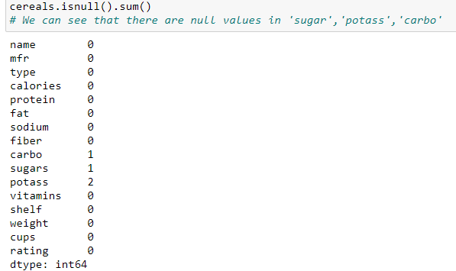
Finding null values
We found there are null values in
Carbo
Sugars
Potass
To find the null value we can use the isnull() method .

Slide 4
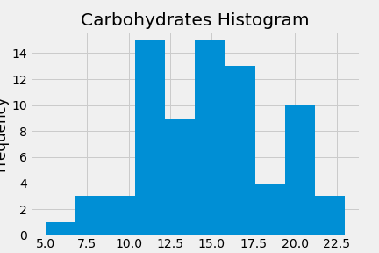
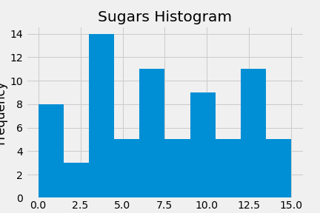
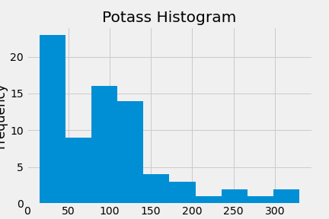
Filling Null Values
Here we are filling the null values using mean or median based on the distribution of the data.
Carbo is normally distributed so we used mean to fill the null values.
Sugar is comb distributed so we used median to fill the null values.
Potass is right skewed and having outliers, so we used median to fill the null values.

Slide 5
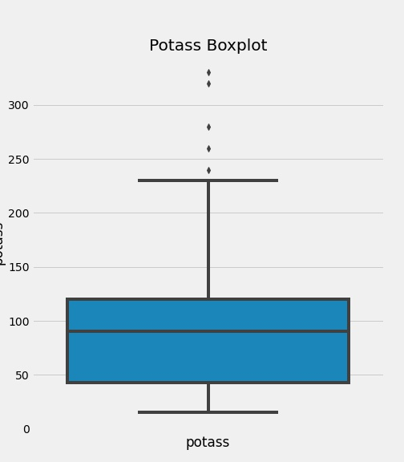
Removing outliers
We found the outliers in potass by plotting the boxplot.
Outliers are problematic for many statistical analyses because they can cause tests to either miss significant findings or distort real results. Therefore we are removing the outliers from potass column.
We found the upper range of the data.
We then assigned the outliers to the upper range.

Slide 6
Finding relationship between columns
We are using correlation matrix to find the relationship between the columns.
The Correlation matrix is an important data analysis metric that is computed to summarize data to understand the relationship between various variables and make decisions accordingly.
There are several types of correlation coefficients, but the most common of them all is the Pearson’s coefficient denoted by the Greek letter ρ (rho)
The value of ρ lies between -1 and +1

Slide 7
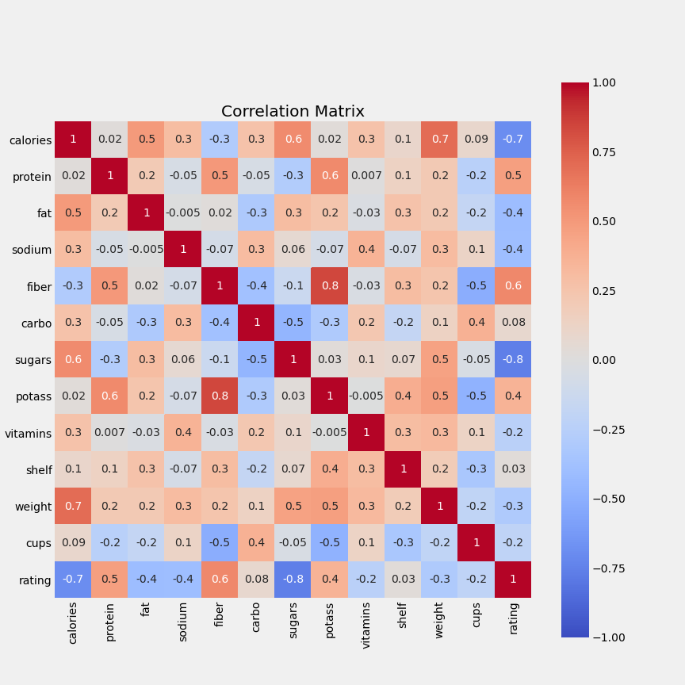
This correlation heatmap infers the following points:
If the calories and sugars in a cereals is high, then the product is more likely to get low rating.
The amount of protein can increase the rating of the cereals.
Similarly the amount of fiber in cereals can also increase the rating.
Fat and sodium level in cereals also seems to decrease the rating.
People prefer to have a healthy diet and hence they upvote products with high amounts of protein, fiber and potass.

Slide 8
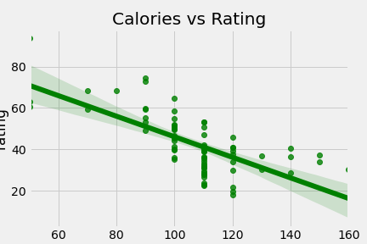
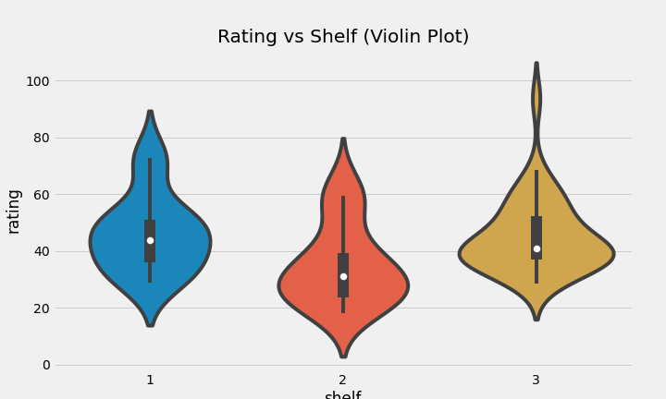
Finding relationship between calories , shelf and rating
From the plot we can see that slope is negative, so as the calories in the cereals increases the rating will be decreasing.
Products placed on the 3rd shelf and 1st shelf are more likely to get high rating. But products placed on the 2nd shelf has a median rating of around 30.

Slide 9
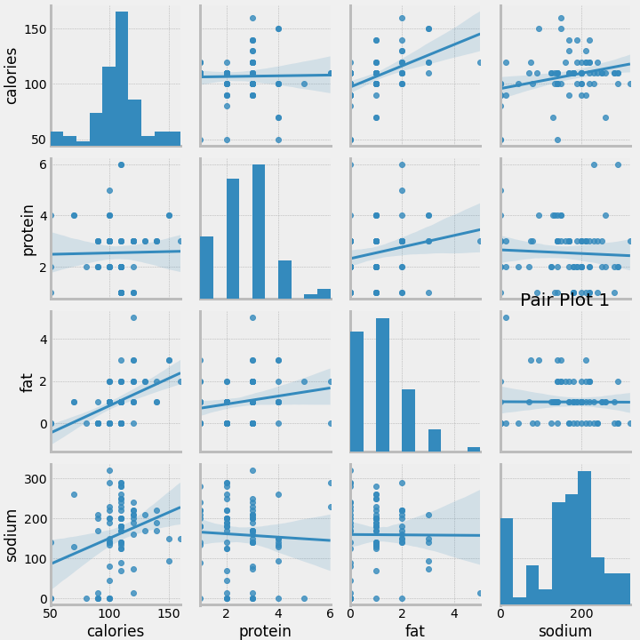
Pair Plot (Plotting all the features against each other) from the data
From the pair plot we can find a lot of information:
As the calories increase, fat content also increases.
Protein and calories have no relation, and are independent of each other.
Across the data, calories are normally distributed.

Slide 10
Findings
1. The features which affects the rating positively are
* protein
* fiber
* potass
2. The features which affects the rating negatively are
* calories
* fat
* sodium
* sugars
3. All other features only mildly affects the rating of the cereals.
4. Ideal proportions in a highly rated cereal
* Calories should be 50 or below
* Protein should be 4 or above
* Fat should be 0
* Sodium should be below 140
* Fiber should be above 14
* Carbo should be near 8
* Sugars should be 0
* Potass should be above 236
* Vitamins should be above 25
* The cereal should be kept on shelf 3
* Weight in ounces of one serving should be 1
* Number of cups in one serving should be 0.5

Slide 11
THANK YOU
Darshan DS
And
Chandhana S

